Slide 1
Tableau Blueprint Introduction Deck (FY22 for Partners)
Deck Last Updated: 12 August 2021
INTERNAL ONLY - PLEASE READ THIS FIRST
What is the Purpose of this Deck?
This deck is intended to be used by Tableau Partners to explain Tableau Blueprint to customers.
How to Use this Presentation:
Tableau Blueprint is a methodology to becoming a data-driven organization. Whether your customer is new to modern, self-service analytics or needs to broaden, deepen, and scale the use of data, Tableau Blueprint provides prescriptive, documented guidance to develop core capabilities and build a thriving Data Culture. This deck provides more detail about the Tableau Blueprint and concludes with a call to action to complete the Tableau Blueprint Assessment.
Notes:
For reference only

Slide 2
Tableau Blueprint
Name, Title
Your methodology to becoming a data-driven organization

Slide 3
Agenda
01
Technology + Culture
What’s different about data-driven organizations?
Tableau Blueprint
How will you drive change, quickly and completely?
Tableau Blueprint Assessment
Where do you start? How do you measure your progress?
Get Started
Where do we go from here?
02
03
04

Slide 4
Technology + Culture
What’s different about data-driven organizations?

Slide 5
Data-driven organization perform better
99%
of Fortune 1000 companies will invest in data and AI in the next 5 years
– New Vantage Partners, 2021
23x
more likely to add customers
1.5x
more likely to grow revenue by > 10%
9x
more likely to retain customers
Notes:
Tableau is on a mission to help people see and understand data. That means more to us now than ever because data gives people a super power, and when people tap into that power, they do incredible things. For example, data-driven organizations are able to get a better picture of what is going on, make smarter decisions faster, and help everyone be aligned and making decisions on data not opinions. Data-driven organizations deliver stronger results. They are:
23x more likely to add customers
1.5x more likely to grow revenue by more than 10% and
9x more likely to retain customers
This is only getting more important, with digital transformation happening faster than ever.

Slide 6
But organizations
are falling short
92%
organizations failing to scale analytics
Notes:
But here’s the hard truth… many organizations are falling short of realizing those outcomes. A recent survey showed that less than 10% of organizations are achieving analytics at scale. The surveyed organizations were seeing data-driven wins here and there, in a single department like HR, for example. But 92% were failing to scale those wins and the capabilities that underpin them from that single department to another or the organization as a whole.

Slide 7
Organizations that don’t scale analytics ask the wrong questions again and again and again
Who has the right skill set and is available to analyze this metric?
Why are my systems so slow? Will I get the results on time?
Am I unlocking business value through my data?
Is this data accurate, complete, reliable, and recent?
Notes:
What’s the result of finding yourself in the 92%? In short, more of the same. Organizations that don’t scale analytics ask the wrong questions… again and again and againWhen searching for the data you need to report on a KPI, perhaps you’re left wondering, “Is this data accurate? Is it complete, reliable, and recent?”
Perhaps you’re a senior leader who doesn’t have access to data to ask and answer your own questions… So you’re left asking, “Is anybody available – who has the right skillset – to conduct this analysis for me?”
And then there’s the most important question of all… “Are we working for the data or is the data working for us? Are we unlocking business value?”
These are the wrong questions to ask, contributing to poor outcomes, employees dissatisfaction, and so much more. This begs the question what do the 8% know that the 92% do not?

Slide 8
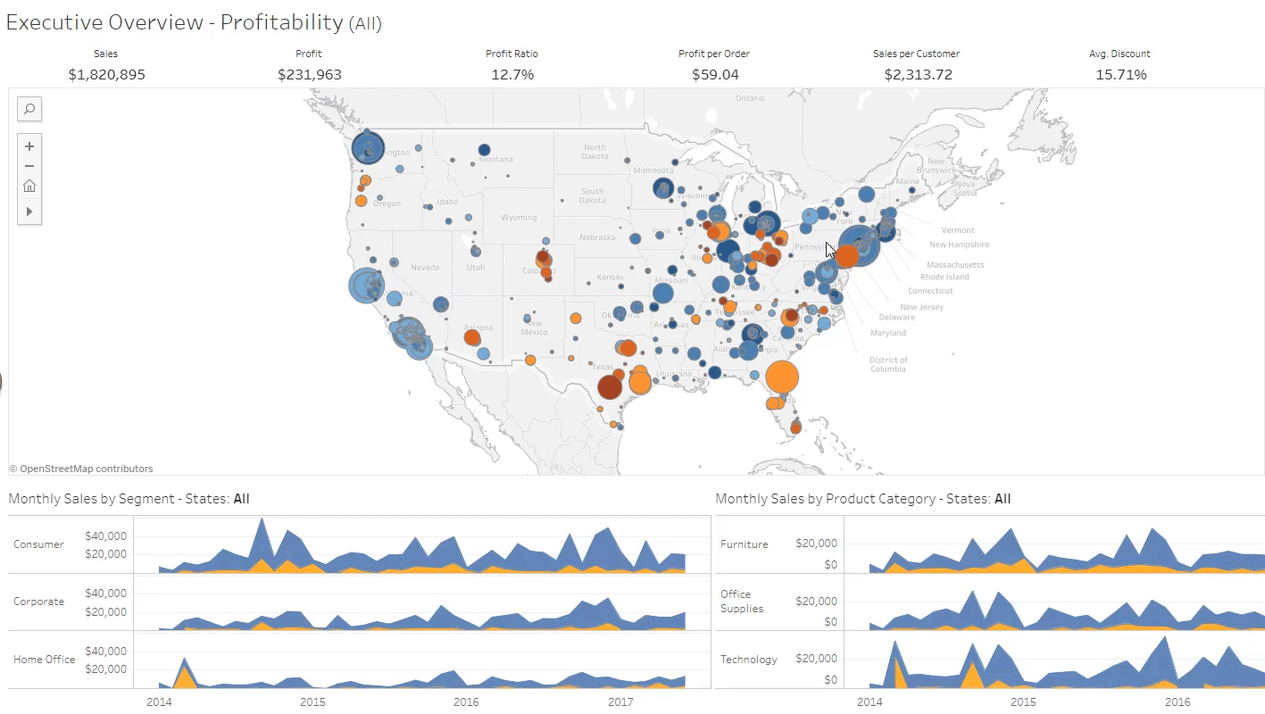
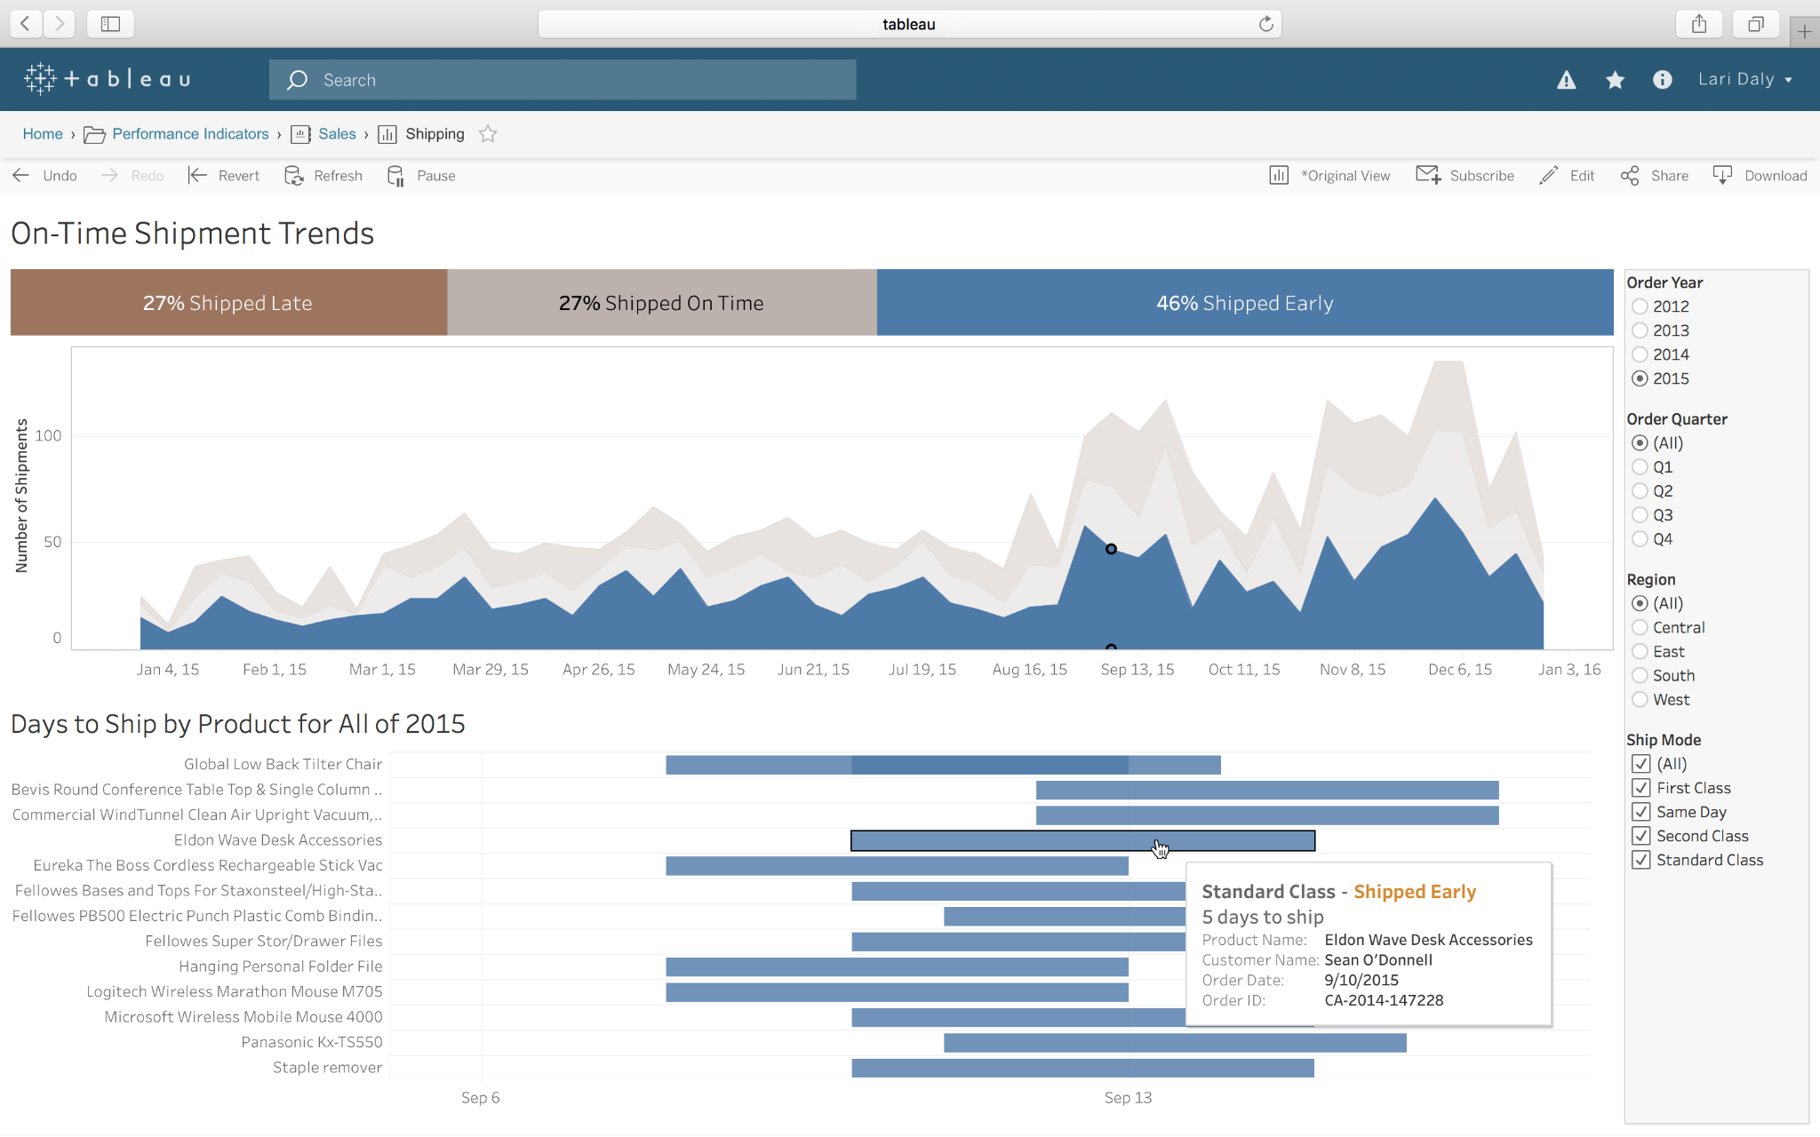
Successful data-driven organizations need the right technology and the right culture

Slide 9
Tableau Blueprint
How will you drive change, quickly and completely?

Slide 10
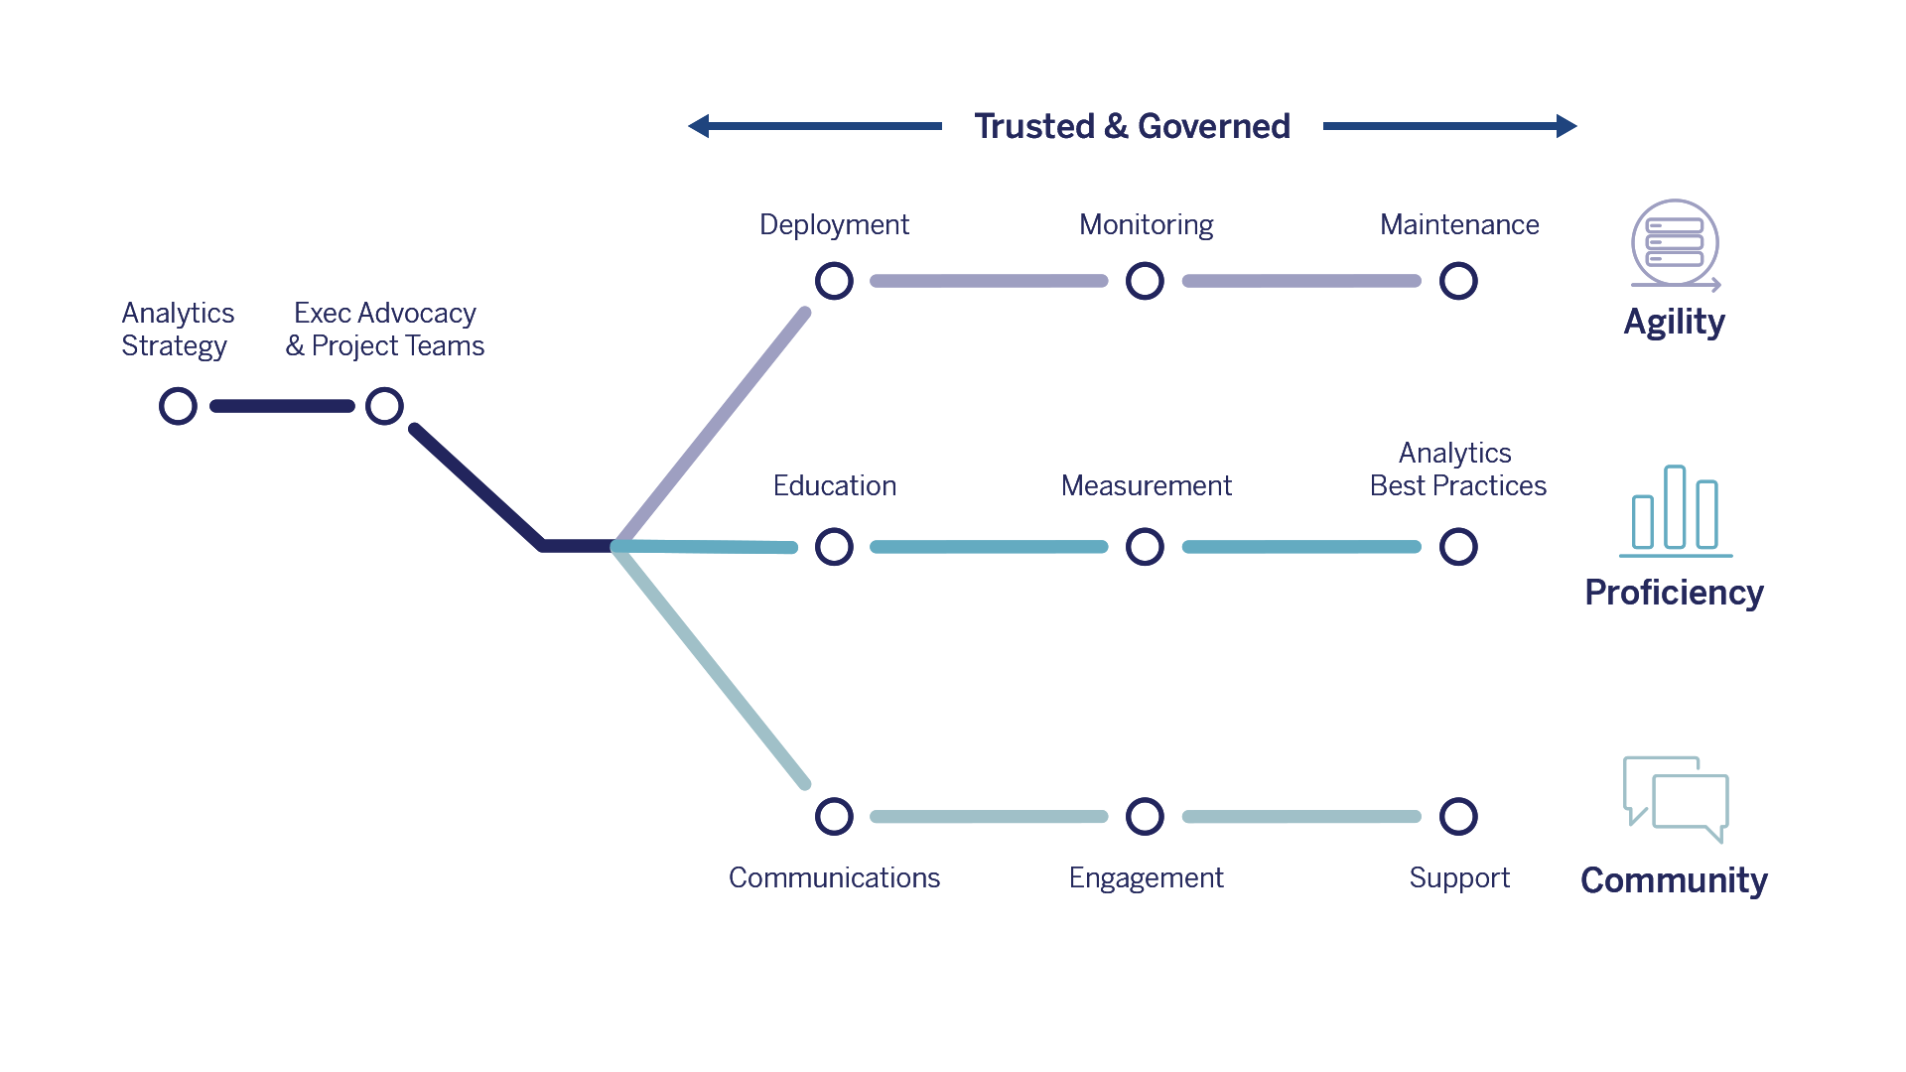
Tableau Blueprint
Your methodology to becoming a data-driven organization
Prescriptive – See the big picture to plan for success and avoid common pitfalls
Repeatable – Right-size repeatable processes, evolve processes into capabilities
Proven – Confidently deploy and operate at scale based on the experience of thousands of customers

Slide 11
Analytics Strategy
Align your organization on a vision for analytics and the roles to get there
Start with business outcomes
Define vision and strategy for analytics
Discover and prioritize use cases
Identify exec sponsors and project teams

Slide 12
Agility
Deploy a secure, stable environment that evolves as business needs change
Build, right-size, and secure your modern analytics environment
Be responsive and scalable to the use of analytics
Develop ongoing change management to upgrade and evolve

Slide 13
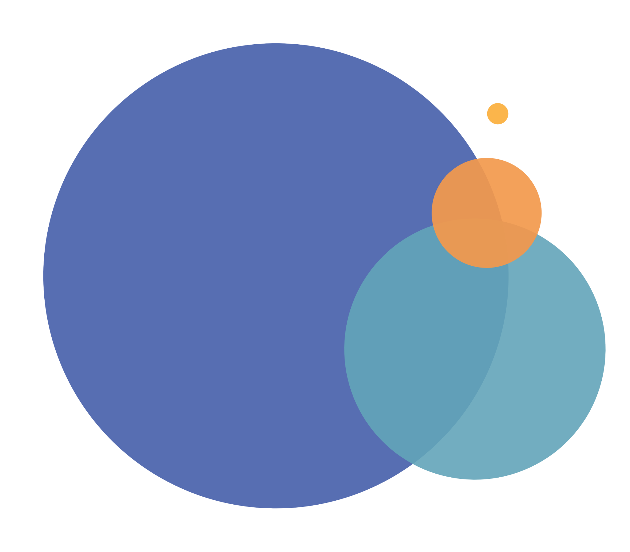
Proficiency
Educate your people to see and understand data for decision-making
Design education programs specific to job roles
Measure user engagement and adoption
Develop organizational best practices

Slide 14
Community
Build a community of data- enthusiasts that inspire and celebrate data-driven wins
Establish easy communication channels
Design opportunities for your community to engage and collaborate
Put processes in place to support your people

Slide 15
Governance
Strike the right balance between security and data access for exploration
Define controles, roles, and processes to govern data and content
Establish governance models: centralized, delegated, and self-governing
Evolve over time

Slide 17
Tableau Blueprint Assessment
Where do you start? How do you measure your progress?

Slide 18
The journey to becoming data-driven is filled with big, interconnected questions
How do I balance security and access for data exploration?
How do I educate people to see and understand data?
Customer Service
connected
99%
of Fortune 1,000 companies will invest in data and AI in the next five years
Tech Executive
Employees
What should my vision for analytics look like? What roles do I need to get there?
Will my environment evolve as business needs change?
Data Executive
LOB Executive

Slide 19
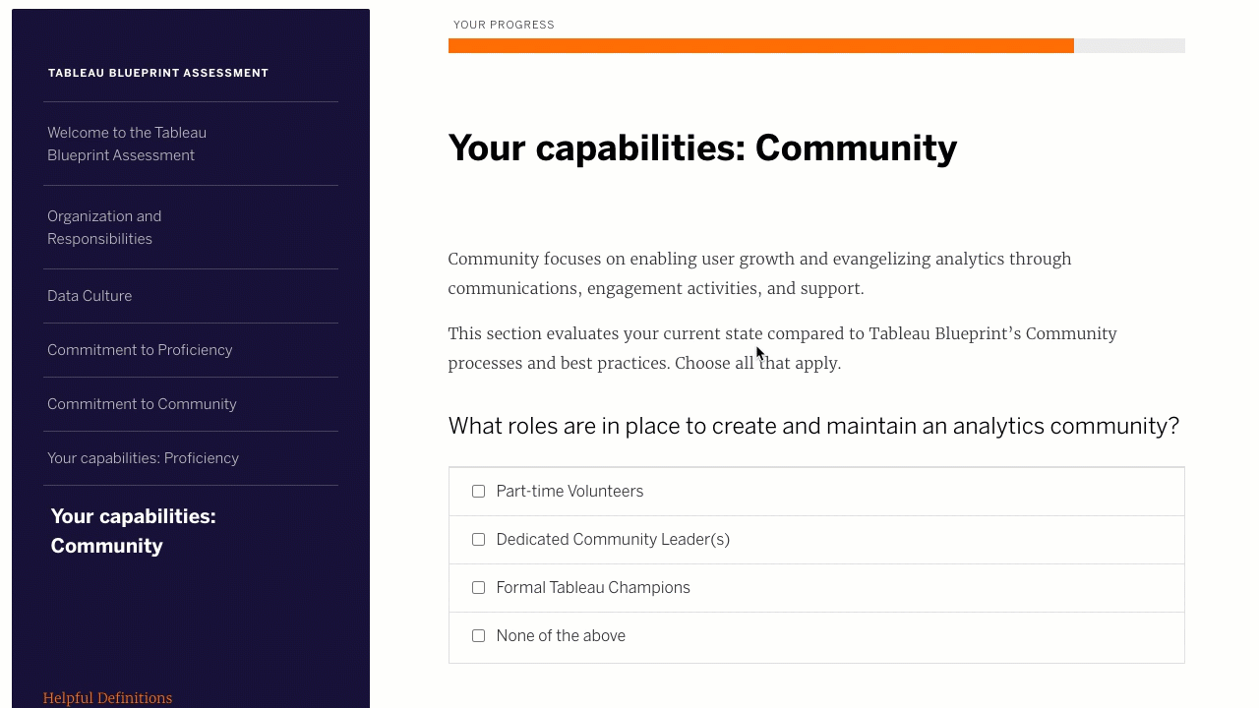
The Tableau Blueprint Assessment
Measure, plan, and build a data-driven organization through the Tableau Blueprint Assessment–based on Data Culture research and the Tableau Blueprint
Measure where you are in your journey to gain data-driven insights on where you need to go
Actionable recommendations to build a plan; plus track your progress along the way
Personalized by level and role to help you drive transformation throughout your organization
Get started at www.tableau.com/blueprint-assessment

Slide 20
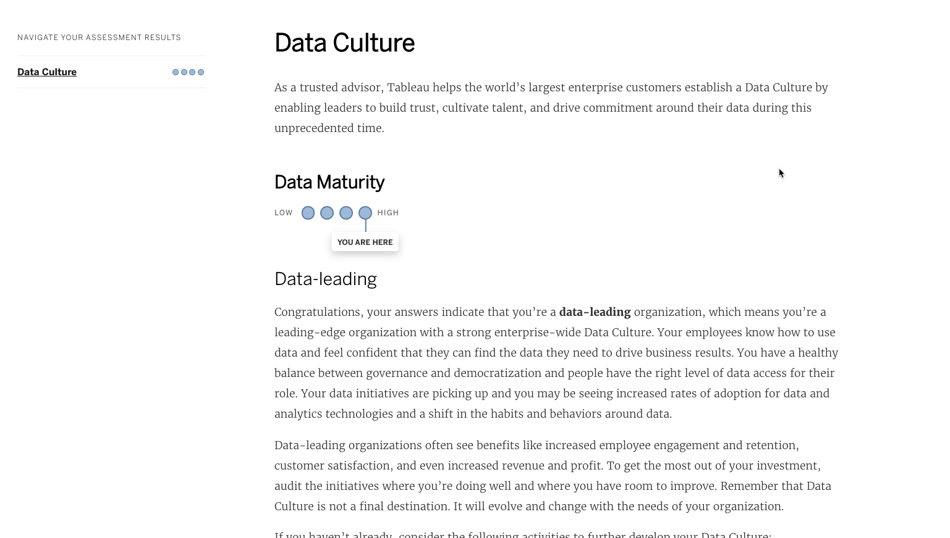
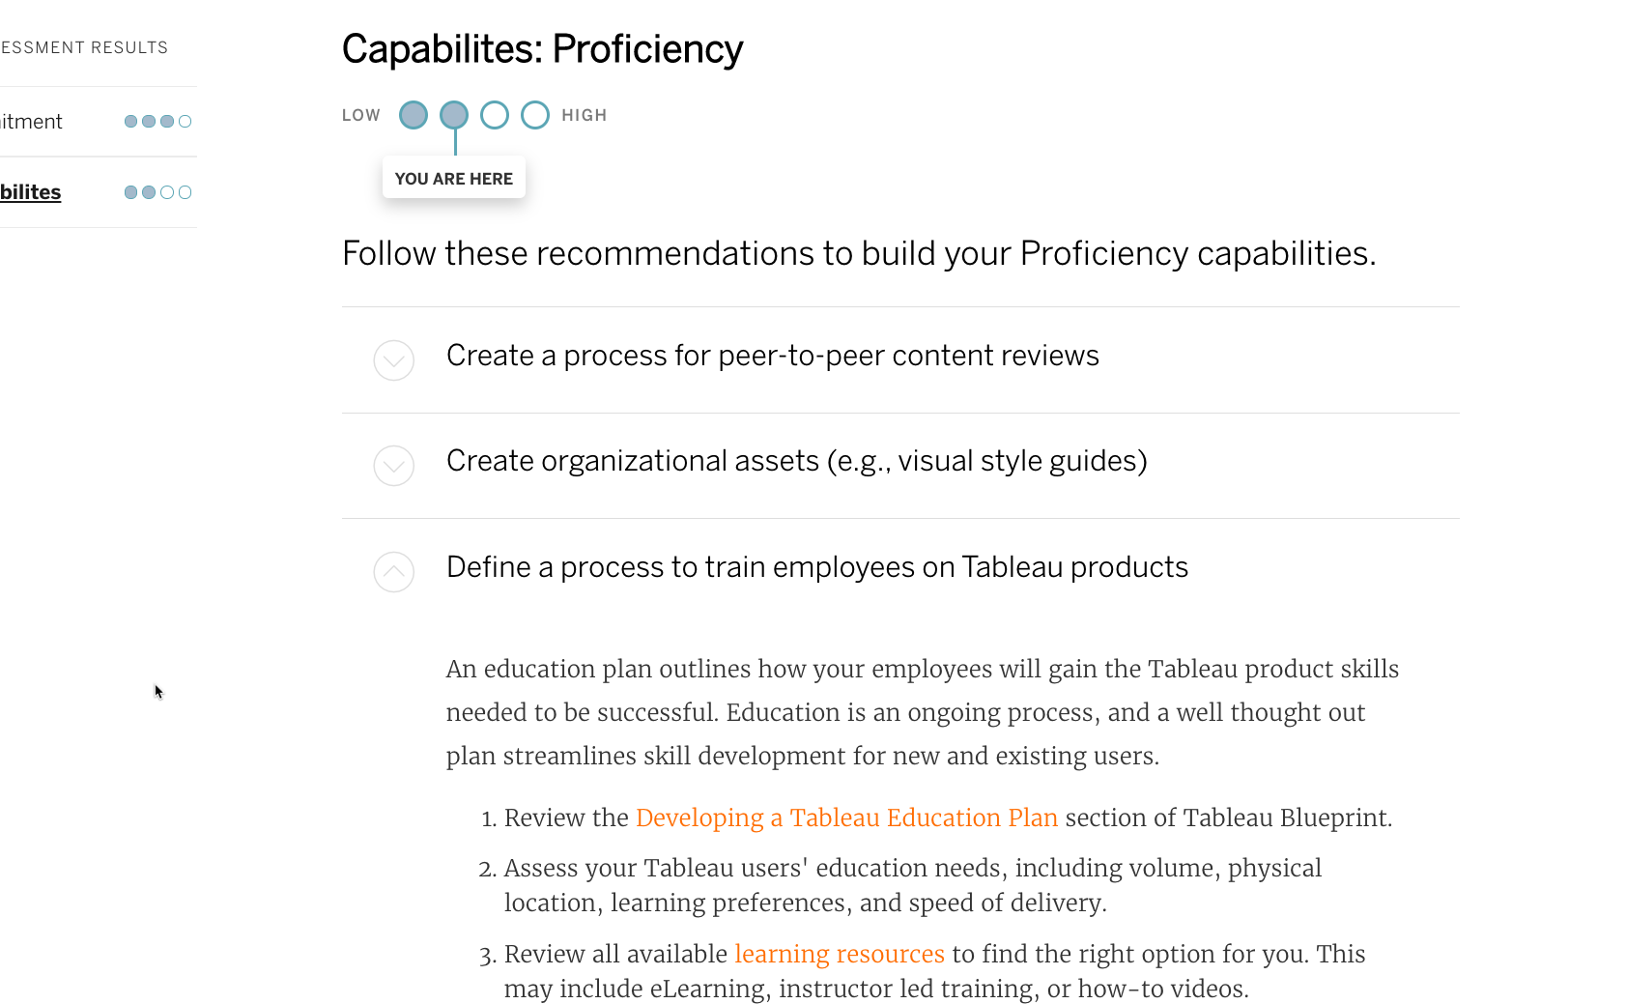
Your Results and Recommended Next Steps
At the end of the assessment, you will receive scores as well as personalized, actionable recommendations
Step-by-step guidance to help you mature your capabilities
Inspiring stories from data-leading organizations
Track your progress by updating your status
As actions are completed, scores will dynamically update

Slide 21
Get Started
Where do we go from here?

Slide 22
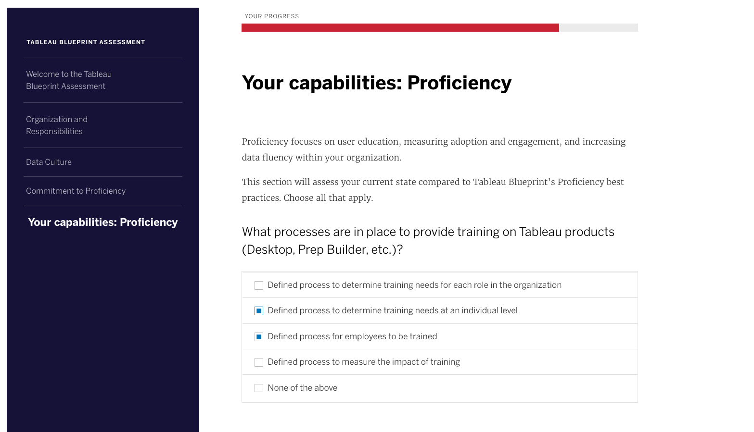
Next Steps: Complete the Tableau Blueprint Assessment
Complete Assessment
Set a due date; each assessment will take no more than 20 minutes to complete
Identify Stakeholders
Identify a broad set of participants to gain a 360 view of your organization
Host a Kick-off Call
Gather participants to discuss the Assessment and outline expectations
Debrief
Host a meeting with all stakeholders to discuss results, recommendations, and next steps

